Slide 1

A Project Report On AUTOMATION TESTING ON SWAGLABS WEBSITE
Mrunali Gautam jawale
Batch: 2022-7895
Course: SCHOOL OF COADING CERTIFIED SOFTWARE TEST ENGINEER
Under the Guidance of,
Mrs.lenna thorat

Slide 2
AIM:
To do overall testing like functional testing on website to check quality of application.
To improve quality of website and saves time for manually doing this testing.
To check functionalities available on website.
SOFTWARE REQUIRMENTS:
Operating System: Windows 10
Browser: Latest version of Chrome
IDE: Eclipse IDE
Automation Tool: Selenium WebDriver

Slide 3
Topic Introduction:
1. To see what attracts visitors to your website
2. To make your website more user friendly and get referrals from happy customers
3. To have confidence that the technical part of your business runs smoothly
4. To make sure your website works fast and is reliable
5. To get a chance to eliminate unexpected errors

Slide 4
Tool Information:
Selenium WebDriver
Open Source
Web Based Application
Free Automation Tool
Languages:- C#,Java,Python,Ruby

Slide 5
TC01-Method which I use:
1)Get():
To Access the Url
2)sendKeys():
For Sending Values
3)implicitWait():
To wait for certain among of time Before it throws Exception
To way the Handling Exceptions
4)Iframe:
Using switchTo()method
Handling By Three Ways:
1)switchTo.frame(int frame Number)
2)switchTo.frame(String frame Number or Id)
3)switchTo.frame(WebElement frame Element)
5)Drop-Down:
The drop-down element as an instance of the Select Class.
Three methods to use it for drop-down:
1)selectByVisibleText()
2)selectByIndex()
3)selectByValue()

Slide 6
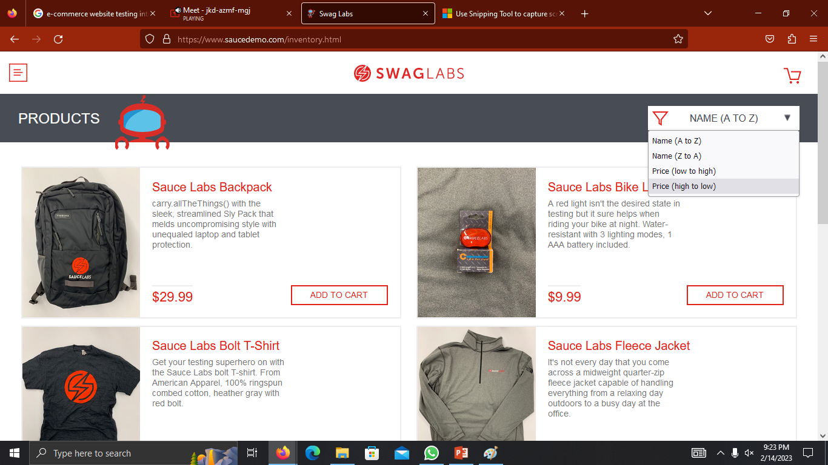
TC03-How to test dropdown
selectByVisibleText(“NAME (A TO Z”);

Slide 7
Challenges:
driver.findElement(By.className("bm-item menu-item")).click();
driver.findElement(By.linkText("text")).sendKeys("suvarna");
This above two lines shows the challenge
I try to inspect element through this two locator by using className and linkText , but this is not work
So I imeplemented by other locators like id,xpath,cssSelector,name

